Slide 1


Bootstrap

Slide 2

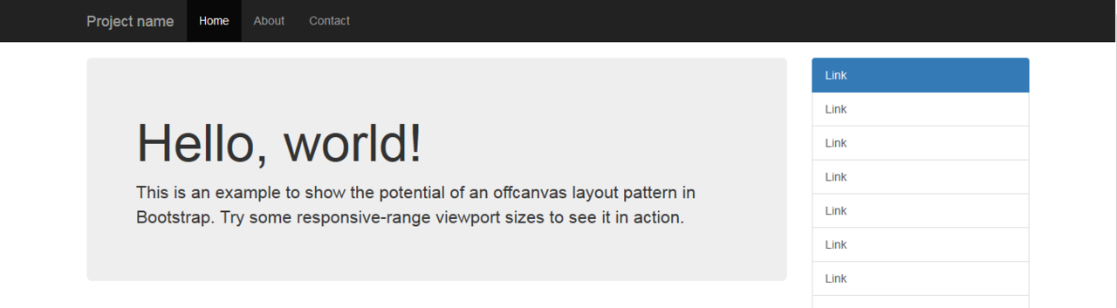
Que es?
framework de CSS
Open Source
Responsive
http://getbootstrap.com/

Slide 3
Como se utiliza?
Habilitando las librerías (dependencias) – CSS / JS
Aplicando “clases”, según la documentación
https://getbootstrap.com/docs/4.3/getting-started/introduction/

Slide 4
Instalación
CSS
<link rel="stylesheet" href="https://stackpath.bootstrapcdn.com/bootstrap/4.3.1/css/bootstrap.min.css" integrity="sha384-ggOyR0iXCbMQv3Xipma34MD+dH/1fQ784/j6cY/iJTQUOhcWr7x9JvoRxT2MZw1T" crossorigin="anonymous">
JS
<script src="https://code.jquery.com/jquery-3.3.1.slim.min.js" integrity="sha384-q8i/X+965DzO0rT7abK41JStQIAqVgRVzpbzo5smXKp4YfRvH+8abtTE1Pi6jizo" crossorigin="anonymous"></script>
<script src="https://cdnjs.cloudflare.com/ajax/libs/popper.js/1.14.7/umd/popper.min.js" integrity="sha384-UO2eT0CpHqdSJQ6hJty5KVphtPhzWj9WO1clHTMGa3JDZwrnQq4sF86dIHNDz0W1" crossorigin="anonymous"></script>
<script src="https://stackpath.bootstrapcdn.com/bootstrap/4.3.1/js/bootstrap.min.js" integrity="sha384-JjSmVgyd0p3pXB1rRibZUAYoIIy6OrQ6VrjIEaFf/nJGzIxFDsf4x0xIM+B07jRM" crossorigin="anonymous"></script>

Slide 5
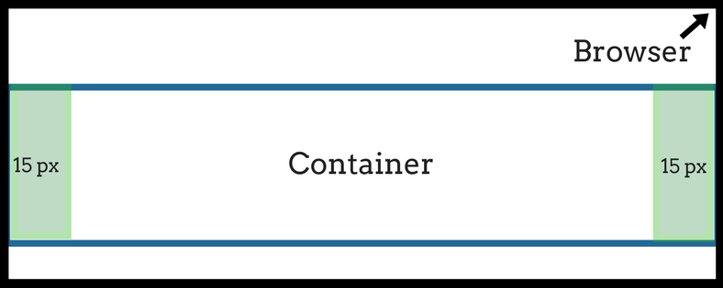
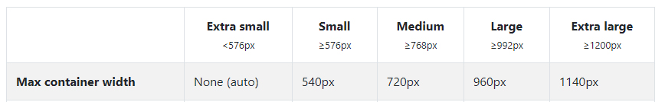
Contenedores
.container

Slide 6
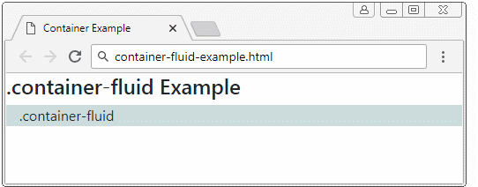
Contenedores
.container-fluid

Slide 7
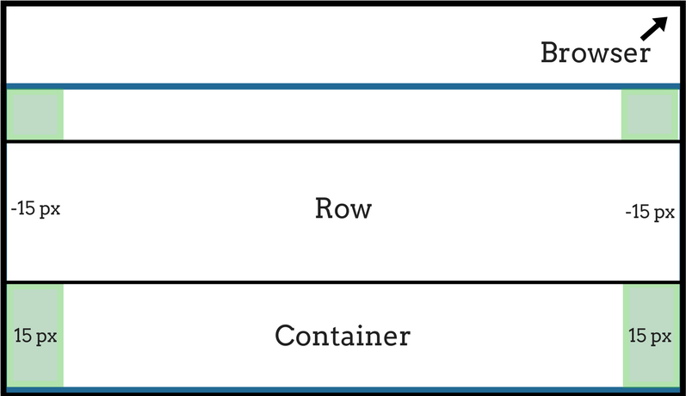
Grilla
.row

Slide 8
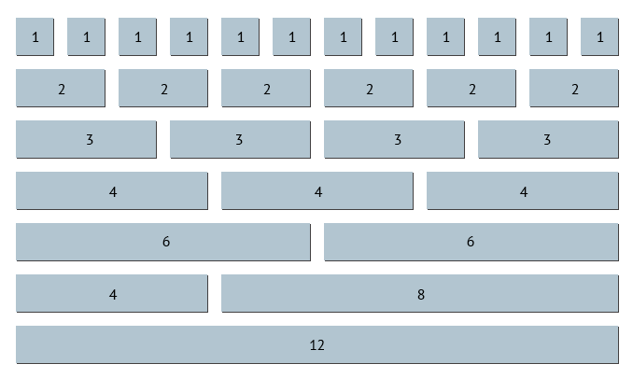
Grilla
.col
xs/ sm / md / lg / xl

